Slide 1

Global Electronics Insights
Presented By-
VenkataSubramanian Sriganesh
Batch Code: MD112

Slide 2
Data Dictionaries Used:
Customers
CustomerKey, Gender, Name, City, State, Code, State, Zip Code, Country, Continent, Birthday
Exchange_Rates
Date, Currency, Exchange
Products
ProductKey, Product Name, Brand, Color, Unit Cost USD, Unit Price USD, SubcategoryKey, Subcategory, CategoryKey, Category
Sales
Order Number, Line Item, Order Date, Delivery Date, CustomerKey, StoreKey, ProductKey, Quantity, Currency Code
Stores
StoreKey, Country, State, Square Meters, Open Date

Slide 3
Libraries used:
Pandas :
For reading the dataset and merging it as Data frames
Datetime :
For calculating the age for the Customers
Sqlalchemy :
For creating a data base connection and loading the data from data frames to SQL as individual tables

Slide 4
Data Pre processing and EDA:
Customers:
Removed the extra columns and kept only the CustomerKey, Gender, Name, Country, State
Calculated the age of the Customers using the calculate_age function
There is no null values in dataset
Products:
Removed the ‘$’ and converted the columns to numeric using to_numeric function
There is no null values in dataset
Sales:
Removed the extra columns and kept only the Order Number, Order Date, CustomerKey, StoreKey, ProductKey, Quantity, Currency Code
Converted Order date from string to datetime format
There is no null values in dataset
Stores:
Replaced the null value for Square meter field for Online as 0
Converted Open date from string to datetime format
Sales:
Converted the Date from string to datetime format
There is no null values in dataset

Slide 5
Final Data Frames:
Sales-Exchange:
Merged sales and exchange data frames on Order Date and Currency code
Customer-Sales-Exchange:
Merged the Customers and sales-exchange data frames on Customer Key
Stores-Sales-Exchange:
Merged the Stores and sales-exchange data frames on Store Key
Product-Sales-Exchange:
Merged the Products and sales-exchange data frames on Product Key
Product-Customer-Sales-Exchange:
Merged the Products and Customer-Sales-Exchange on Product Key
Added the new columns after converting the Currency code for the Converted Cost in USD and Converted Price in USD

Slide 6
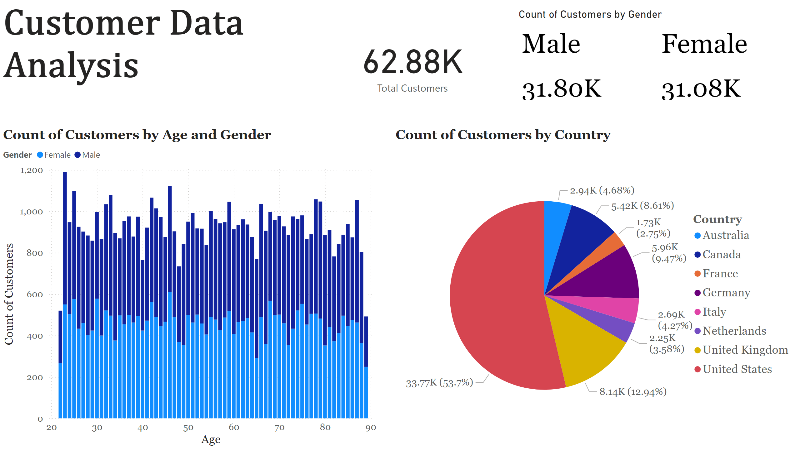
Page 1
Notes:
pieChart
No alt text provided
columnChart
No alt text provided
card
No alt text provided
textbox
No alt text provided
treemap
No alt text provided

Slide 7
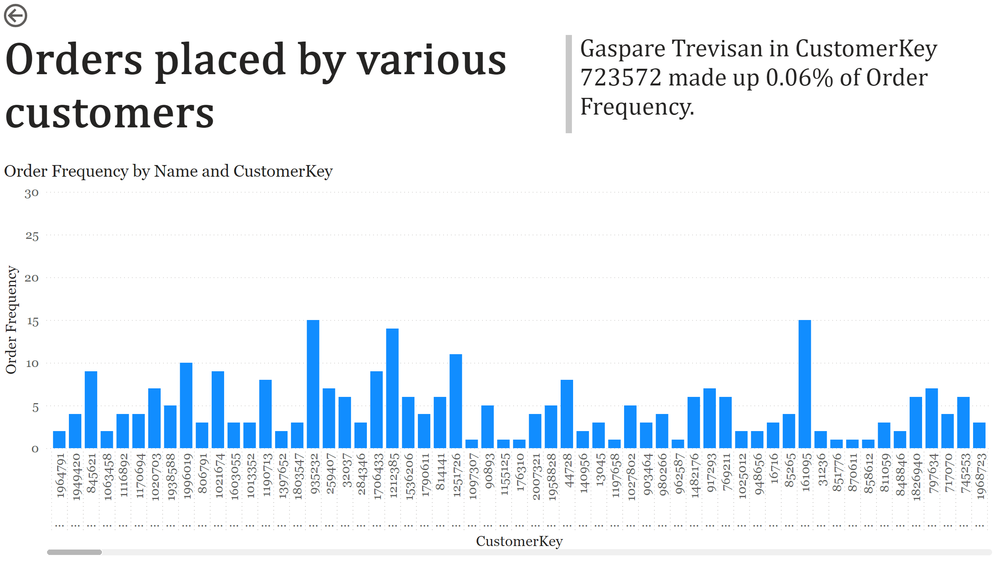
Page 2
Notes:
actionButton
No alt text provided
clusteredColumnChart
No alt text provided
textbox
No alt text provided
textbox
No alt text provided

Slide 8
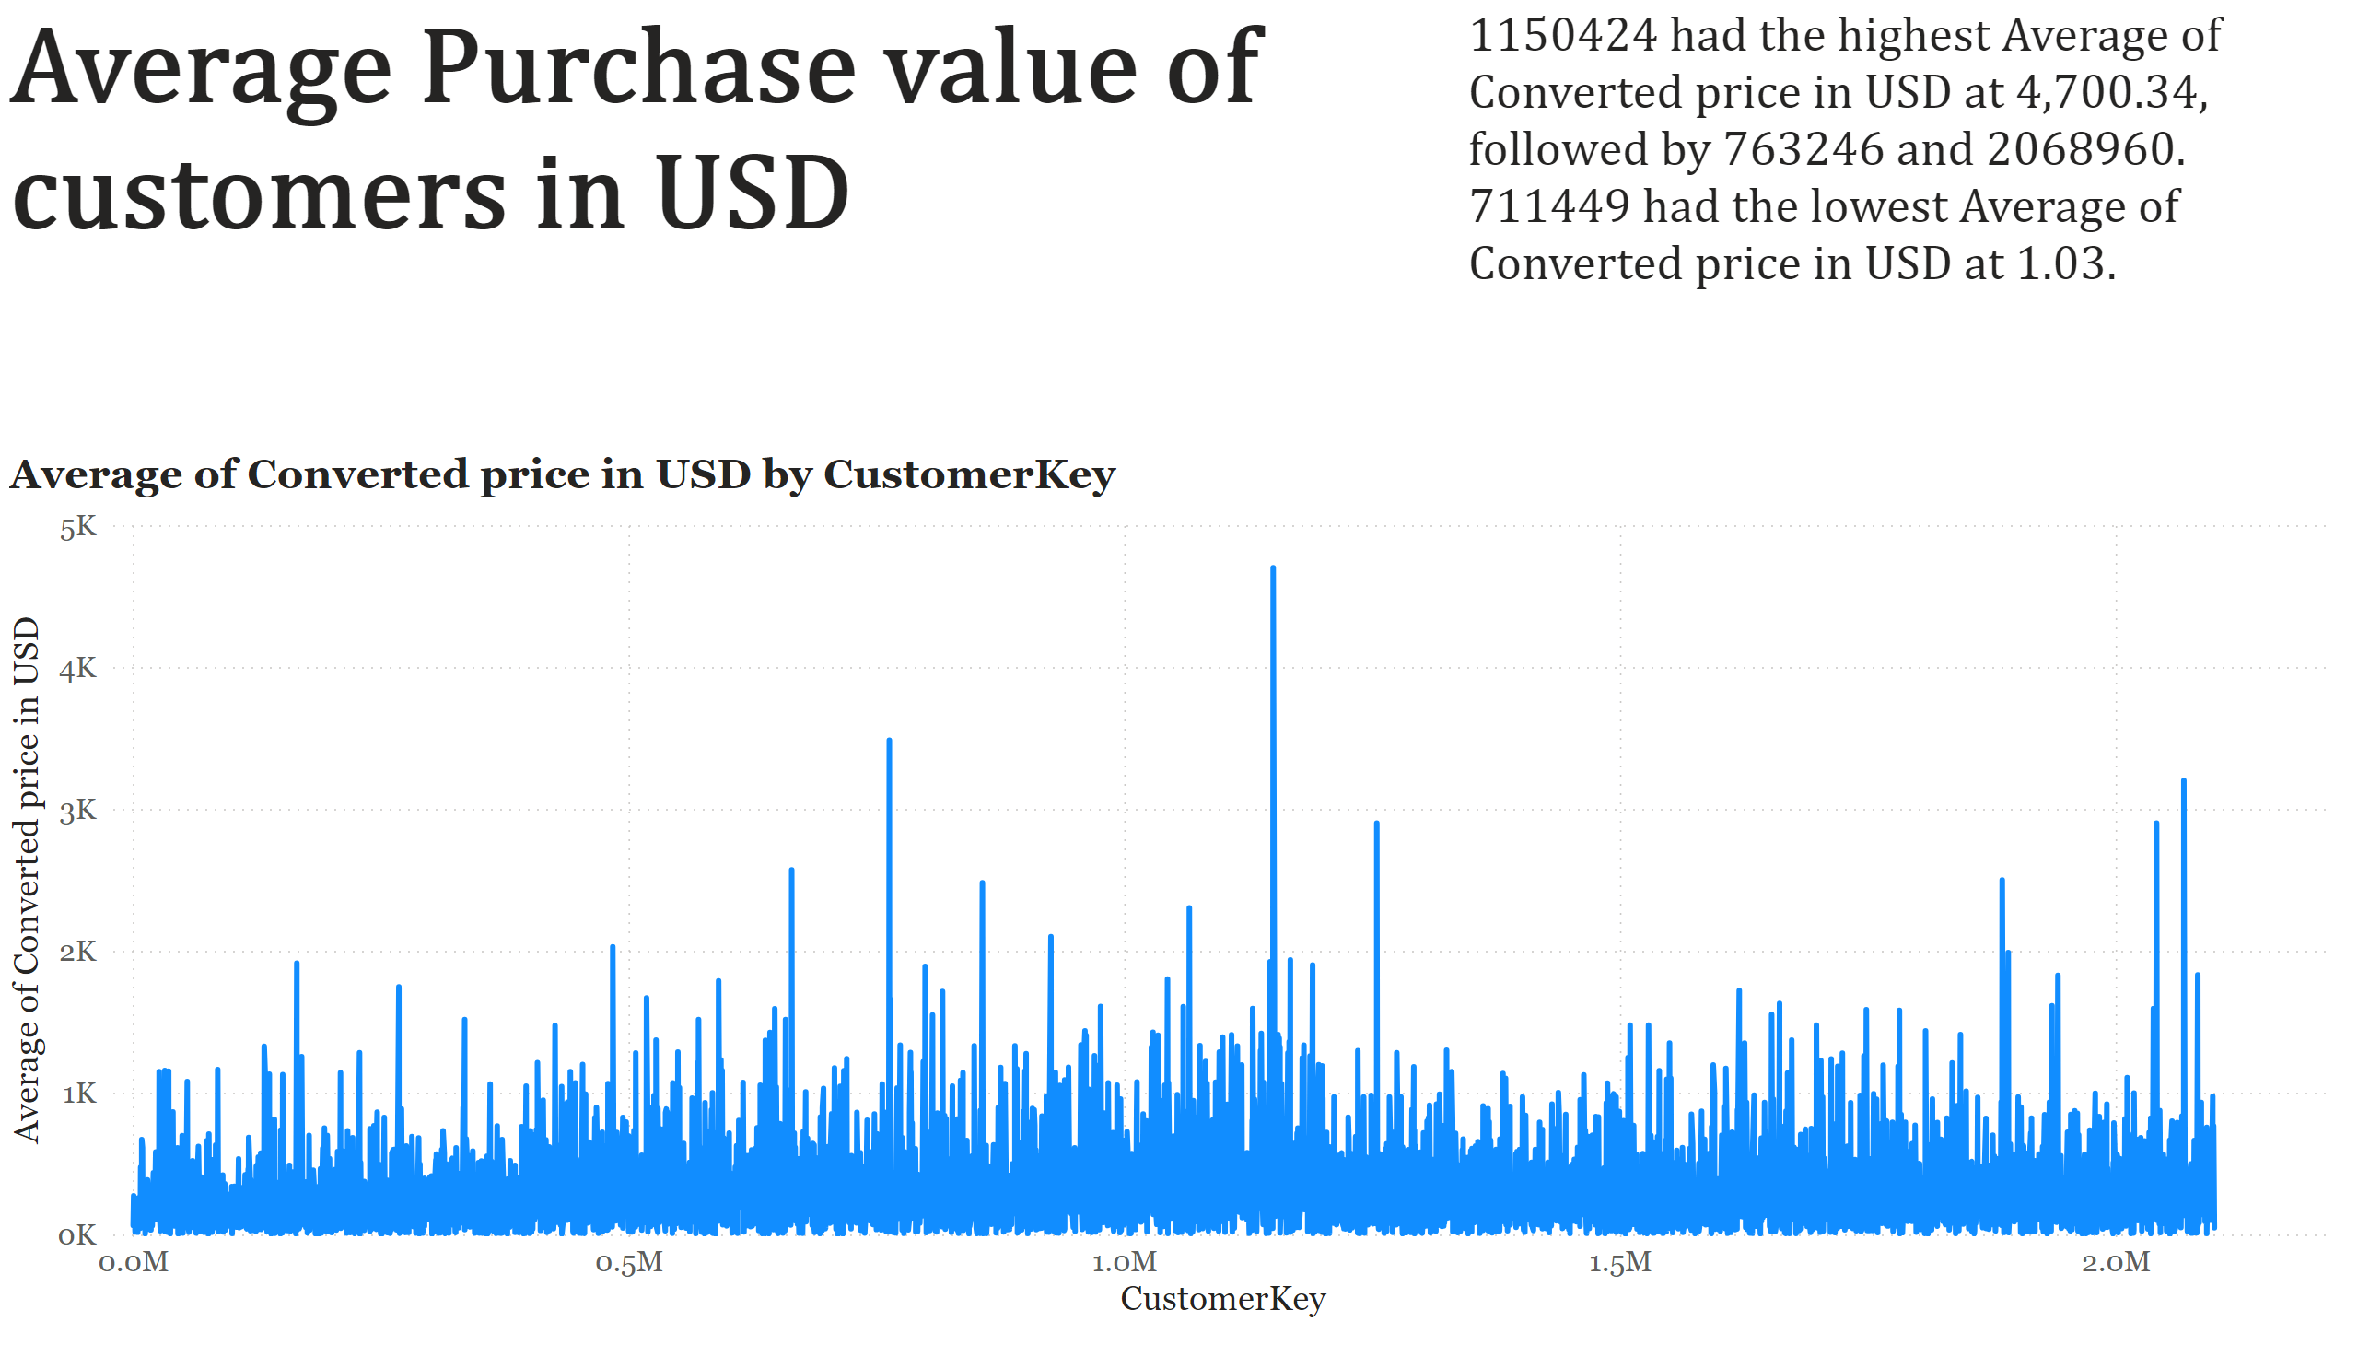
Page 3
Notes:
lineChart
No alt text provided
textbox
No alt text provided
textbox
No alt text provided

Slide 9
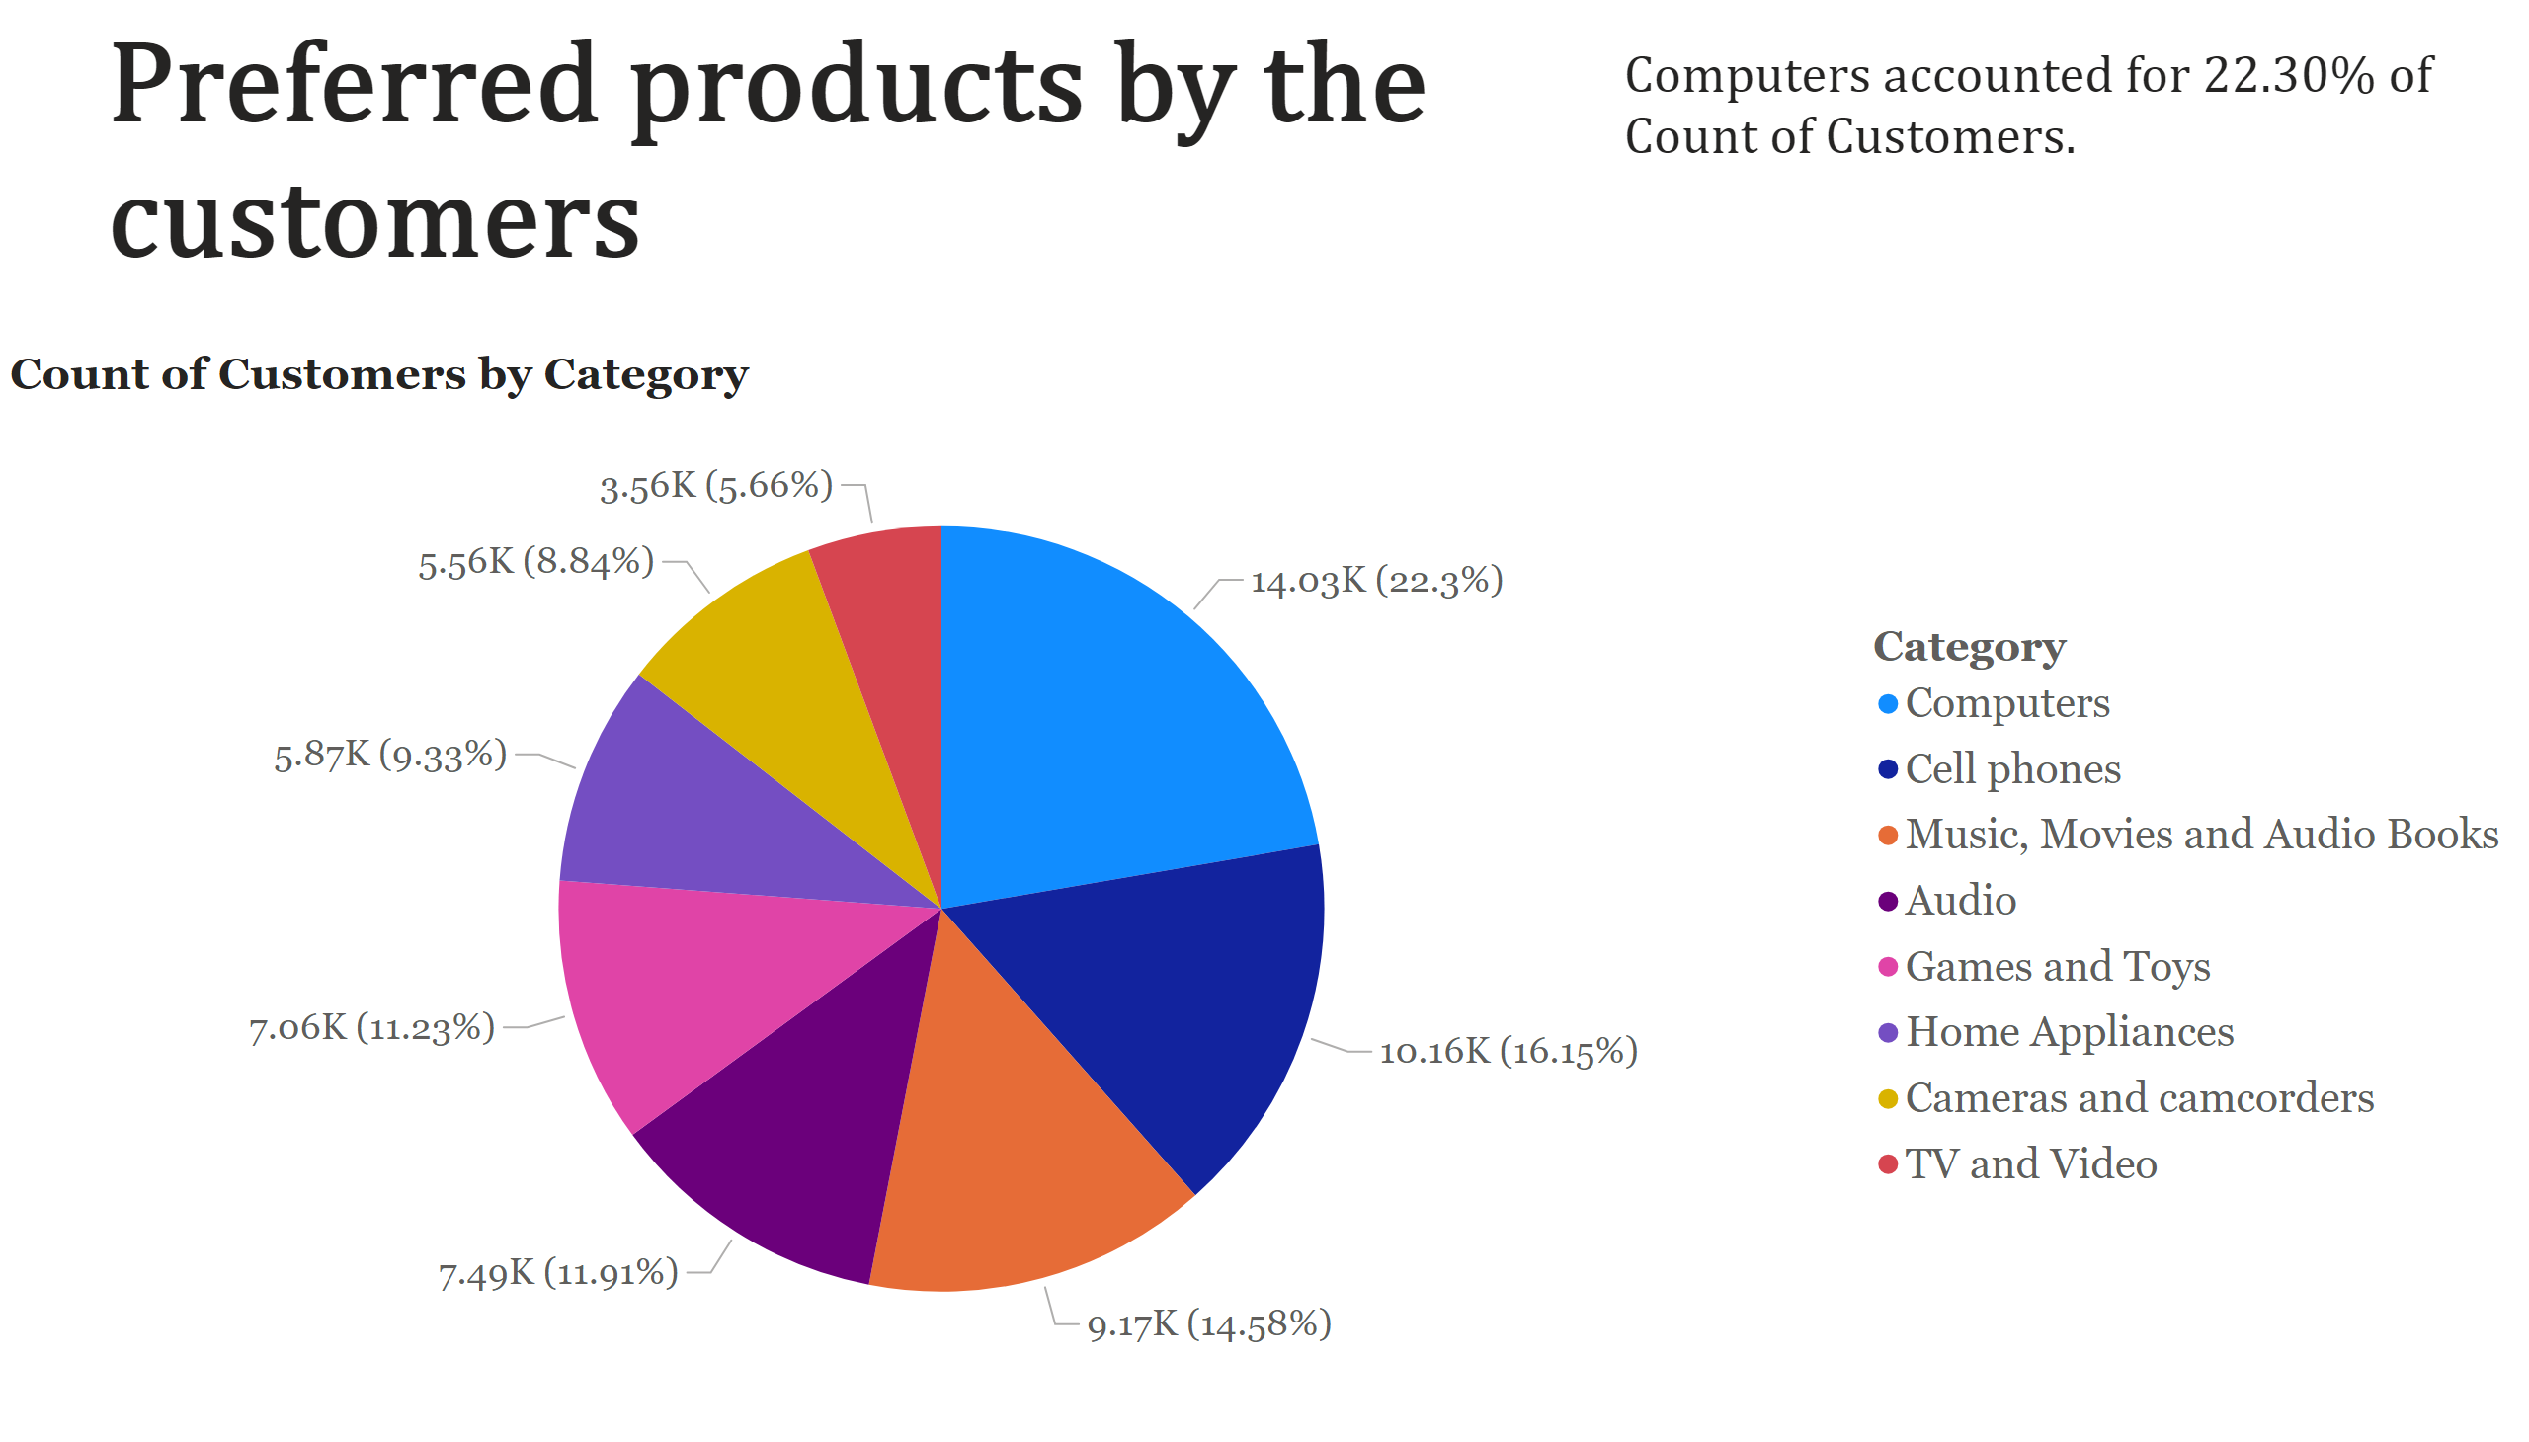
Page 4
Notes:
pieChart
No alt text provided
textbox
No alt text provided
textbox
No alt text provided

Slide 10
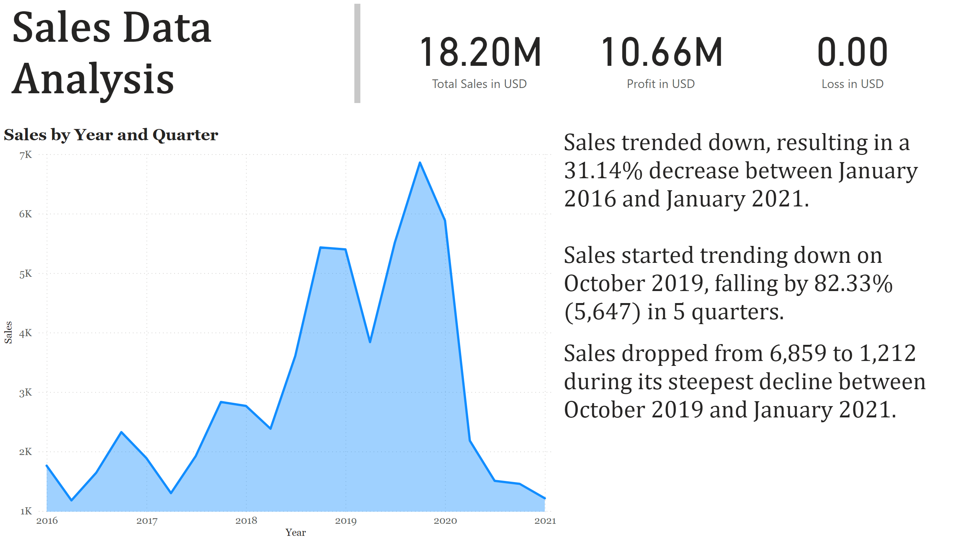
Page 5
Notes:
textbox
No alt text provided
card
No alt text provided
card
No alt text provided
card
No alt text provided
stackedAreaChart
No alt text provided
textbox
No alt text provided

Slide 11
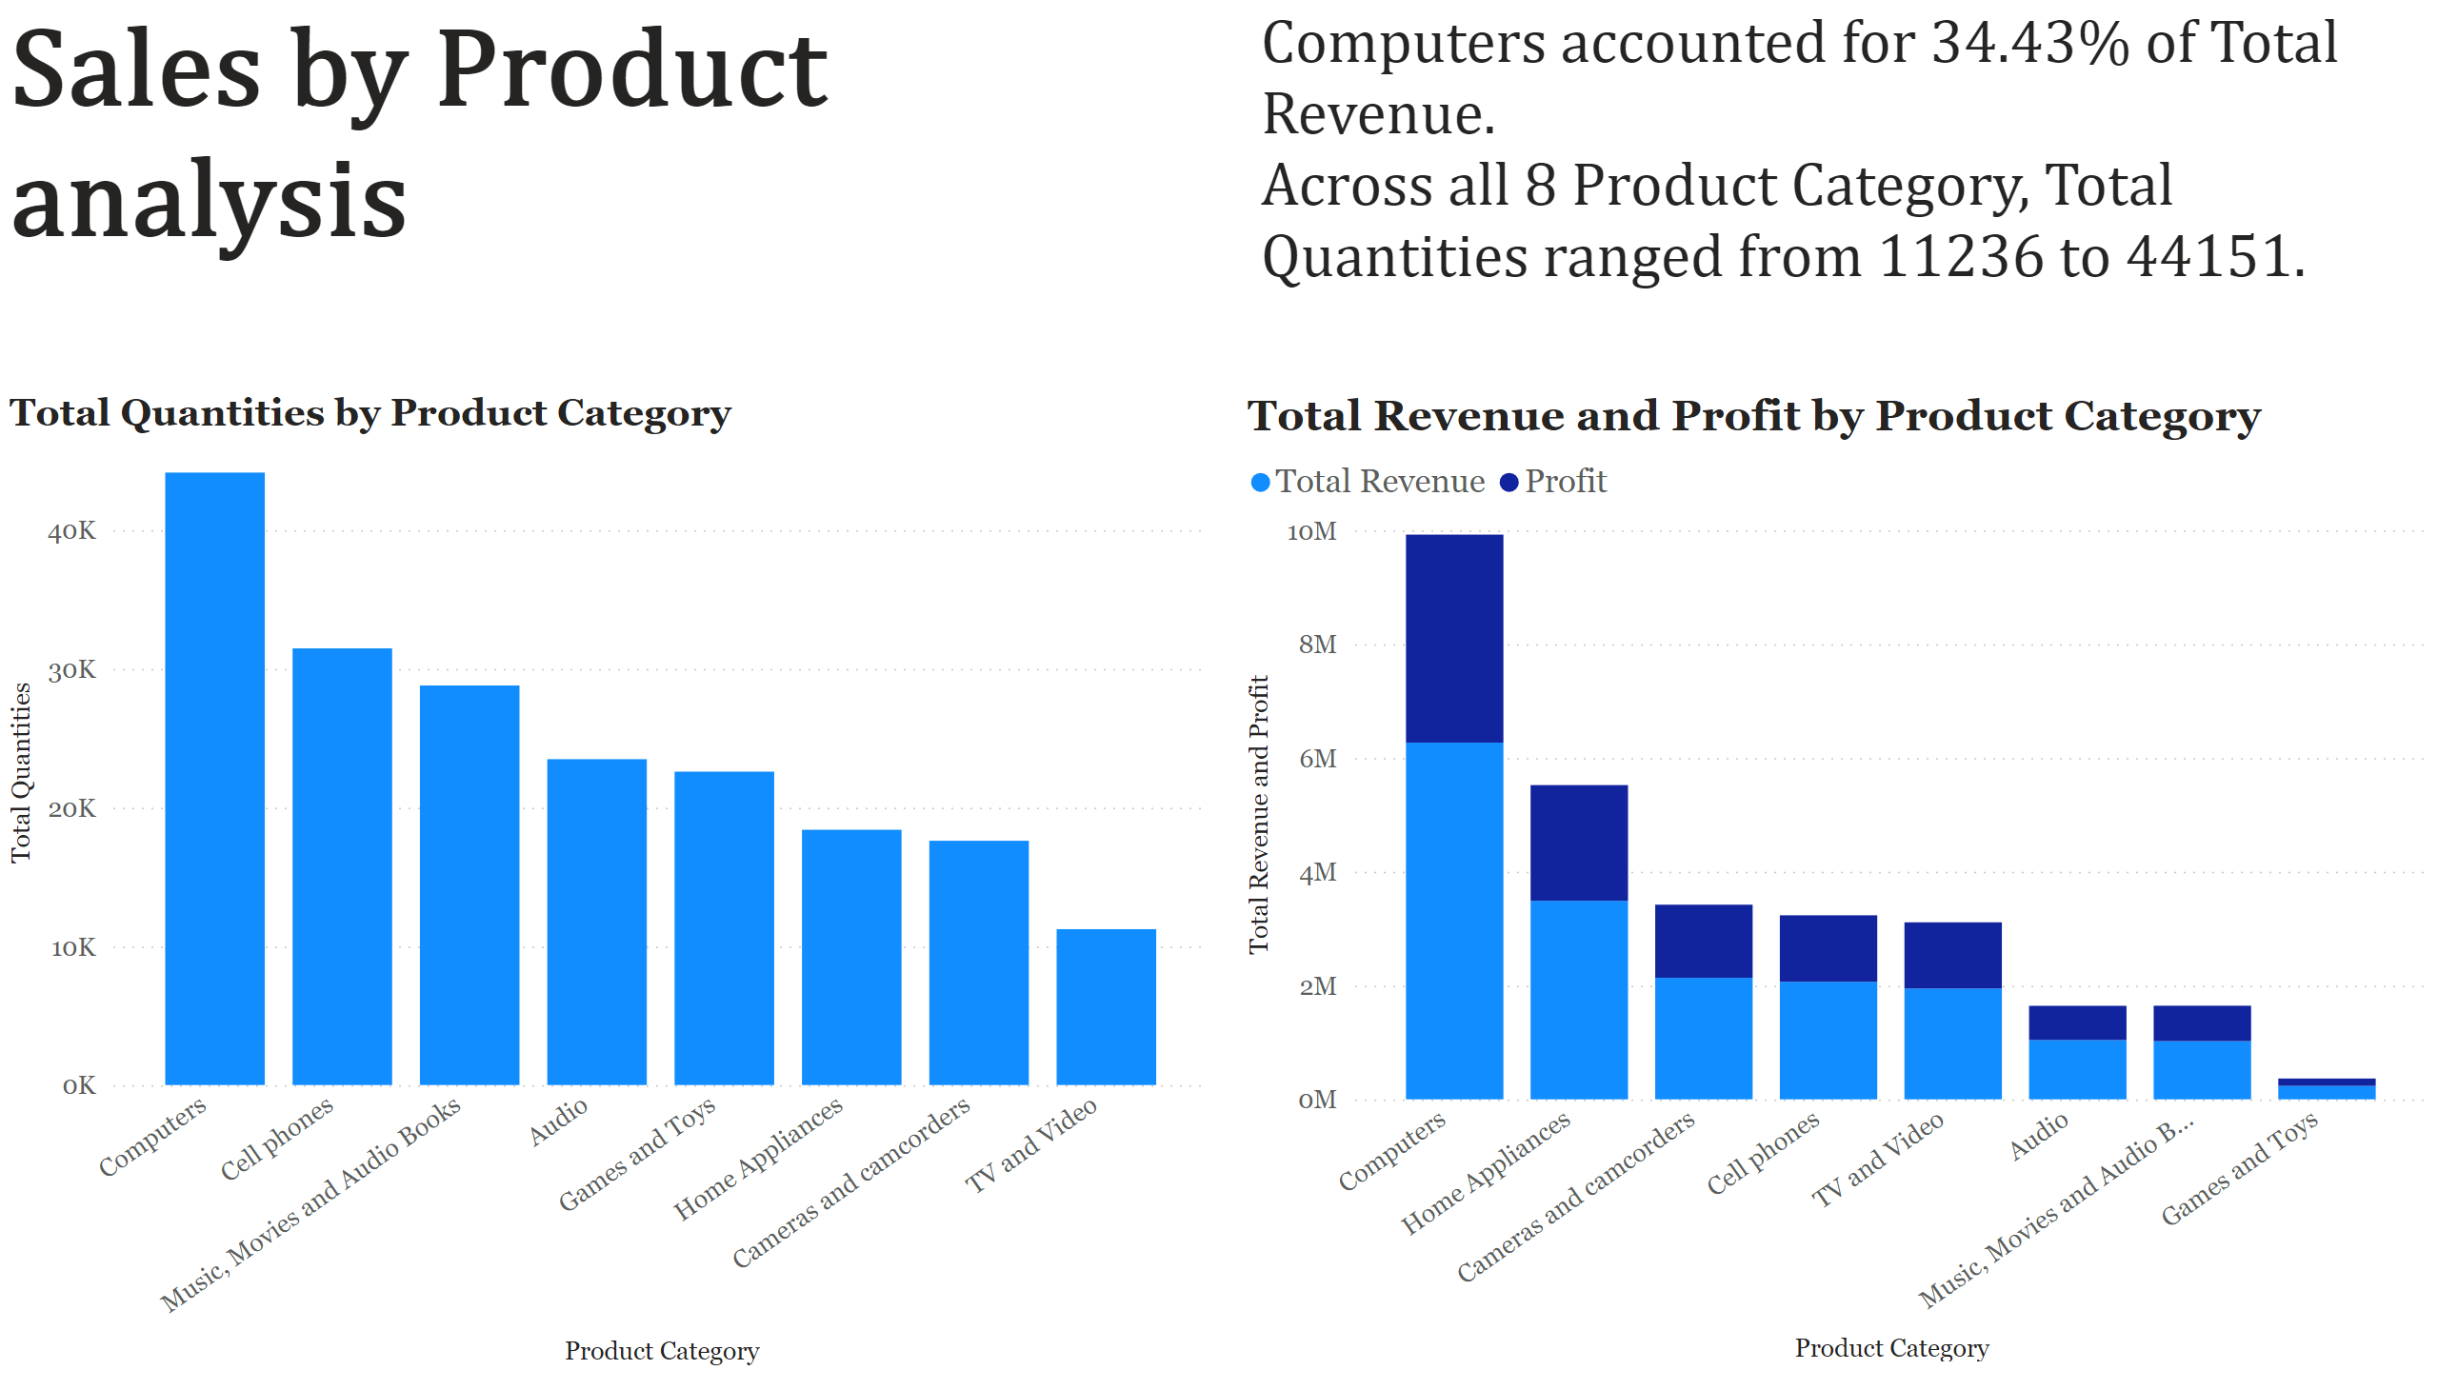
Page 6
Notes:
columnChart
No alt text provided
lineStackedColumnComboChart
No alt text provided
textbox
No alt text provided
textbox
No alt text provided

Slide 12
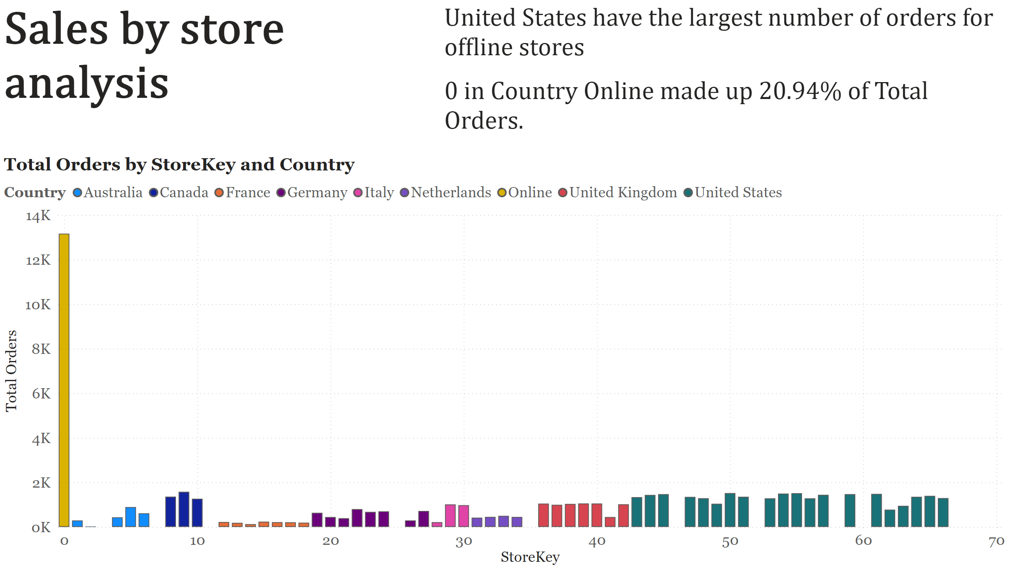
Page 7
Notes:
columnChart
No alt text provided
textbox
No alt text provided
textbox
No alt text provided

Slide 13
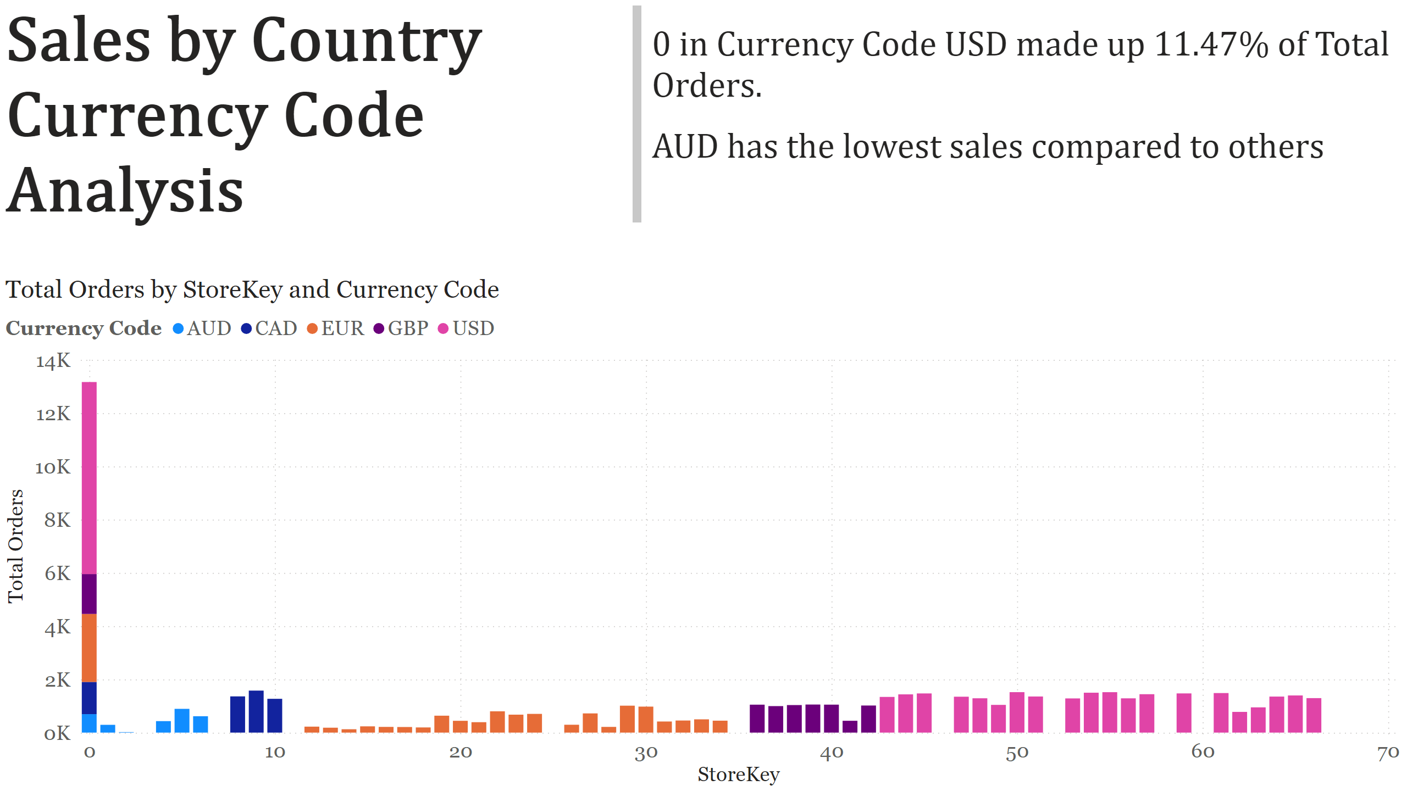
Page 8
Notes:
columnChart
No alt text provided
textbox
No alt text provided
textbox
No alt text provided

Slide 14
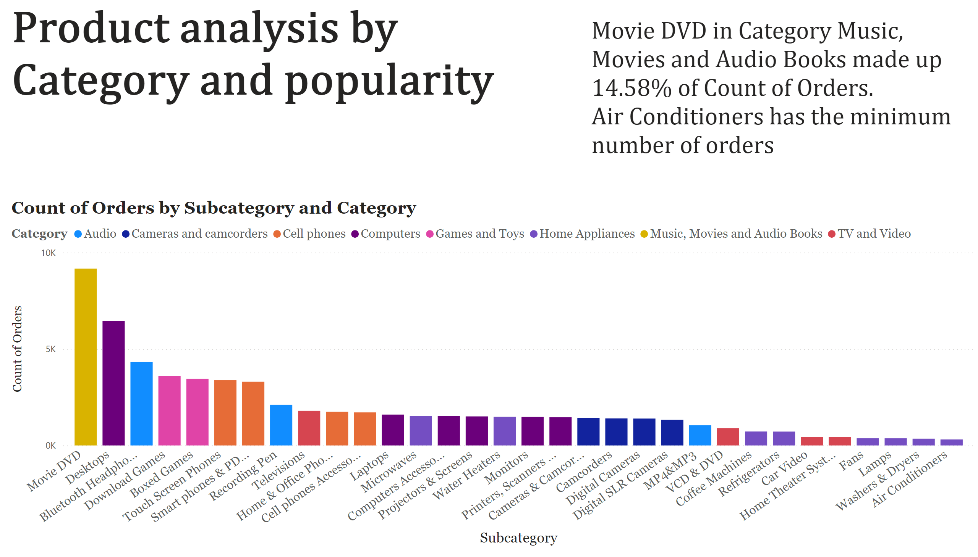
Page 9
Notes:
columnChart
No alt text provided
textbox
No alt text provided
textbox
No alt text provided

Slide 15
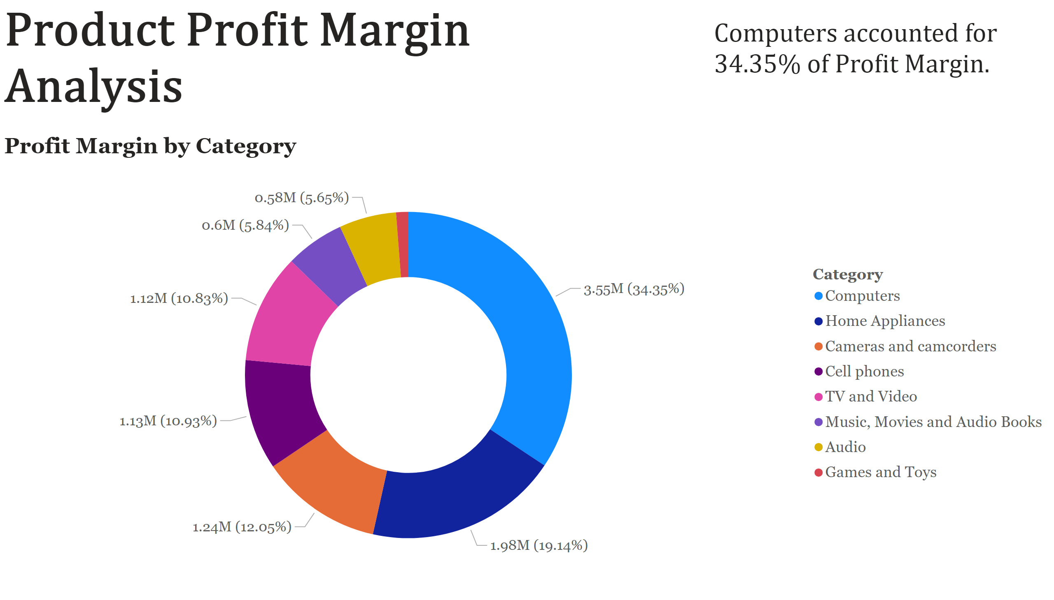
Page 10
Notes:
donutChart
No alt text provided
textbox
No alt text provided
textbox
No alt text provided

Slide 16
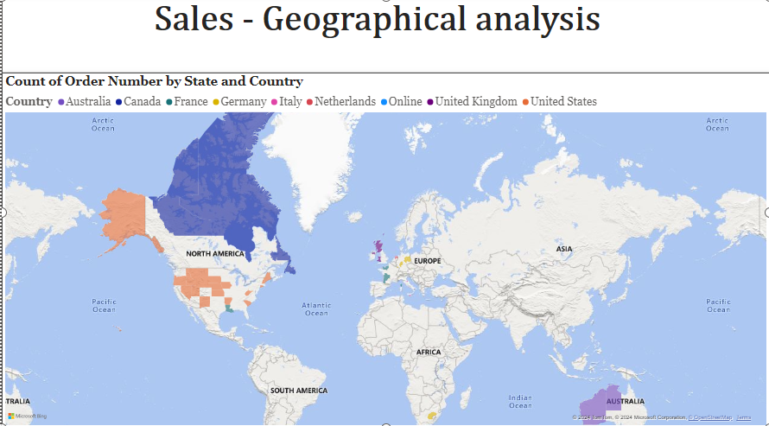
Page 11
Notes:
filledMap
No alt text provided
textbox
No alt text provided

Slide 17
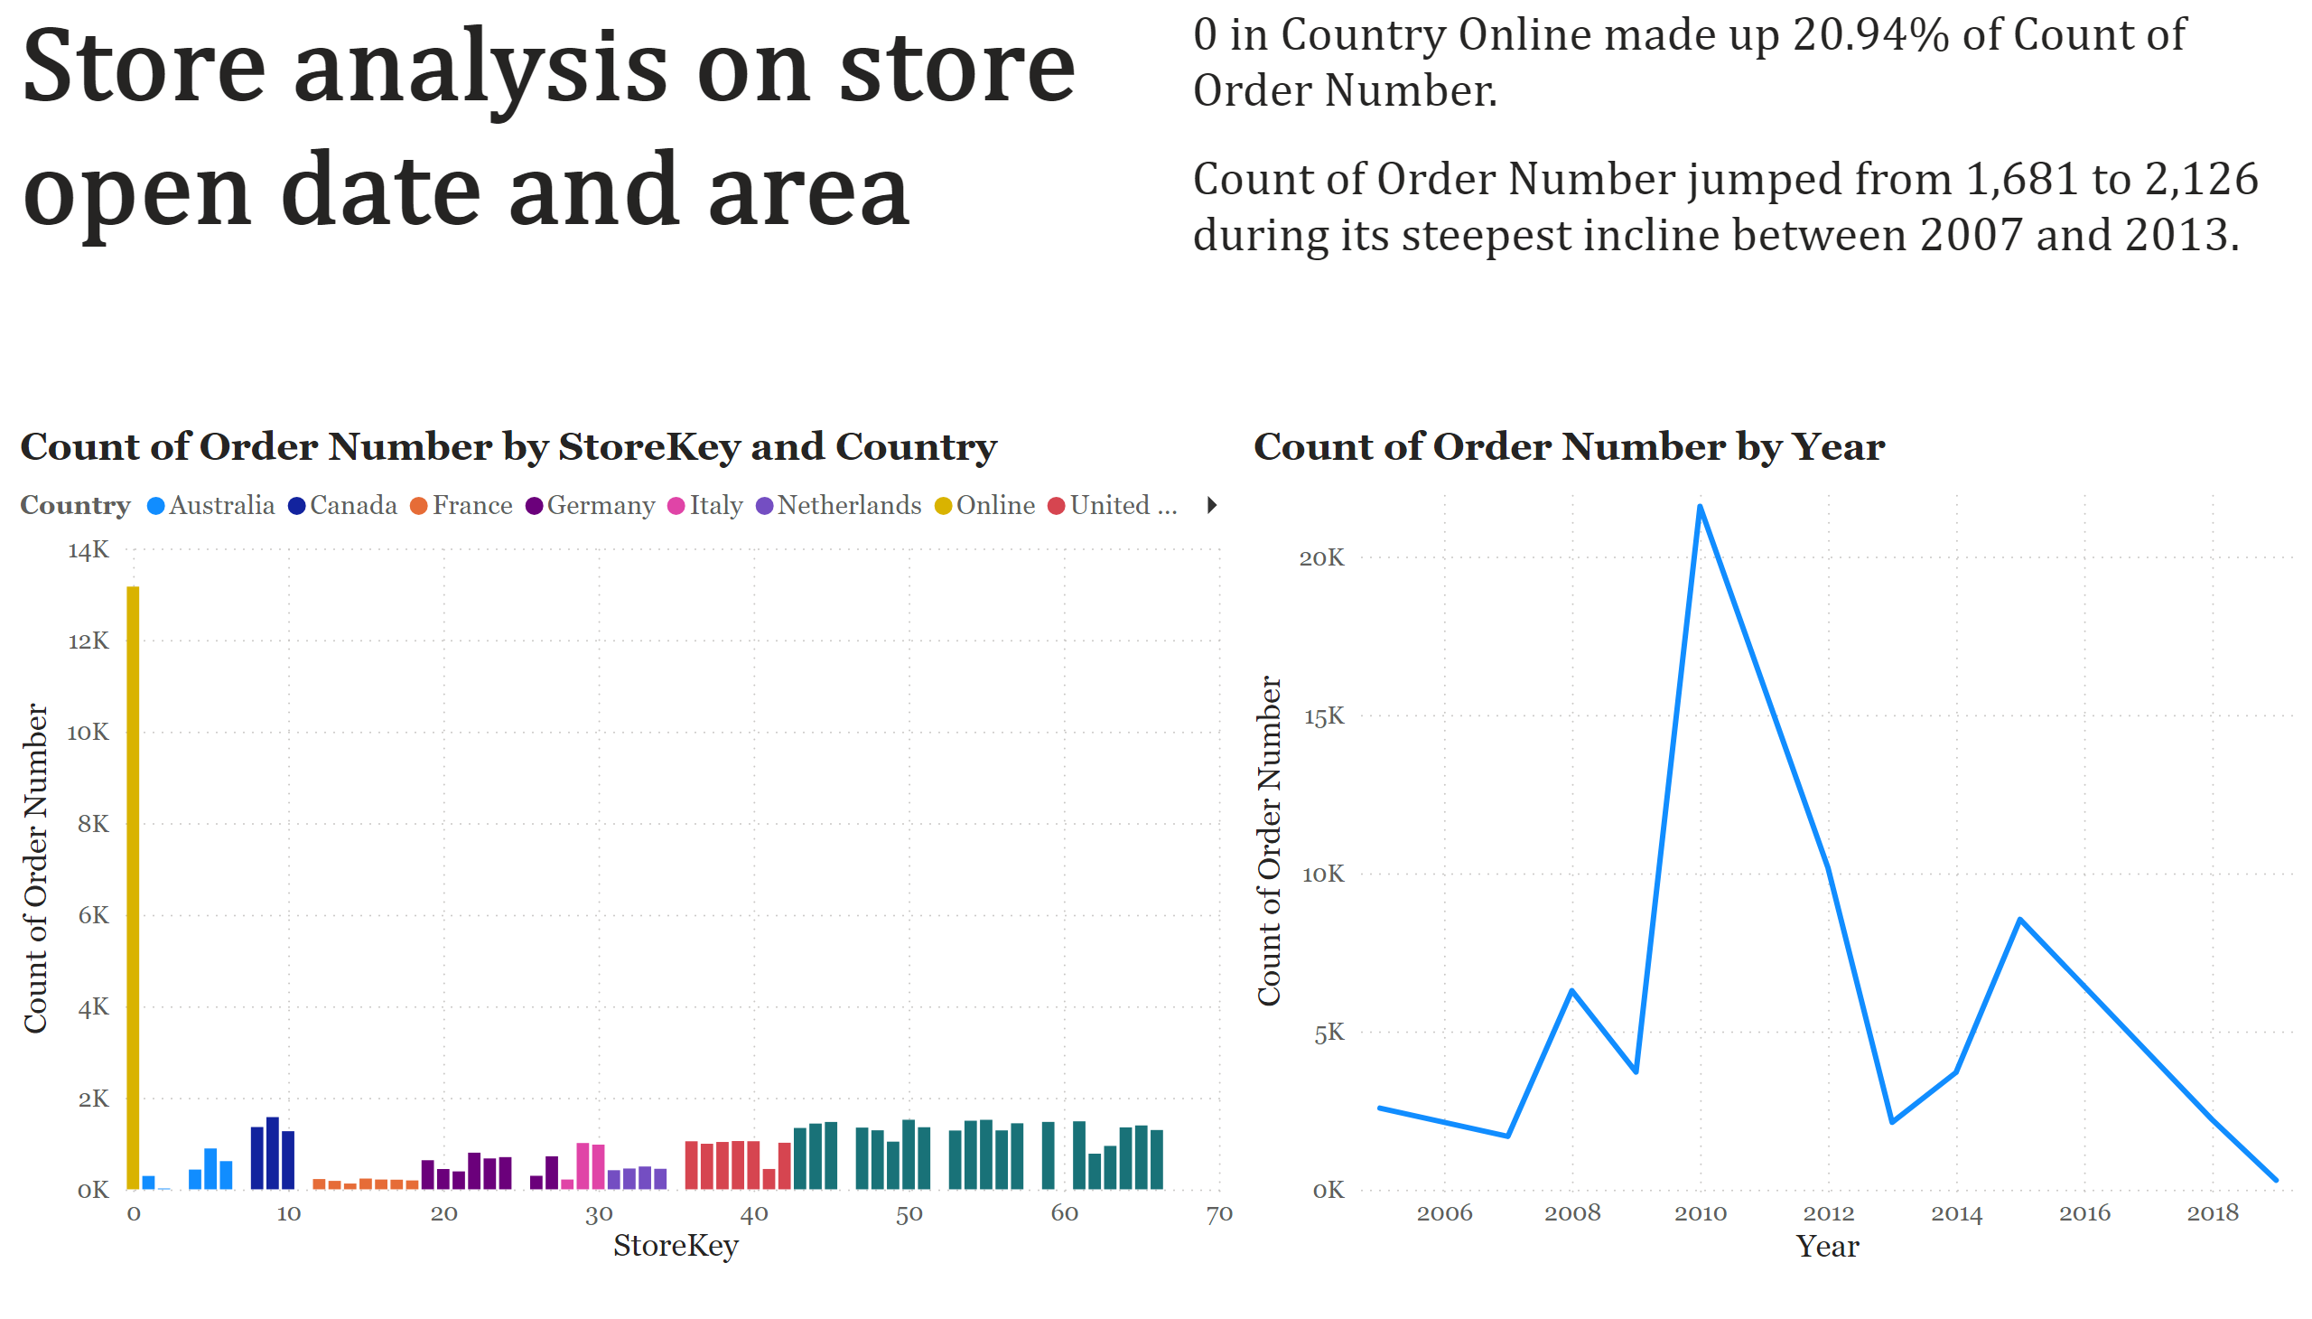
Page 12
Notes:
lineStackedColumnComboChart
No alt text provided
lineChart
No alt text provided
textbox
No alt text provided
textbox
No alt text provided

